Slide 1
Localr - Sprint 0
Chino Catane
Surya Das
Austin Gary
Riana Jara
Nhat Le
Alex McBride

Slide 2
Preface
WHAT IS THE PROBLEM?
Advancement of technology has made news more accessible/available. We now have smartphones, tablets, and other devices to help get our news on-the-go. This has led to:
globalization of news
social media reporting
fake news
Irrelevant news
People find out about something happening in another country, faster than they would about something happening in their city.
WHAT IS OUR SOLUTION?
An easy-to-use mobile application that shows and categorizes for users the headlines and stories in their city through a no-nonsense maps interface.
LOCALR

Slide 3
Preface (cont'd)
WHY WE DECIDED TO PURSUE LOCALR? WHAT PROBLEMS DOES IT ADDRESS?
Make news more relevant to the user
Make news more local
Not only make news easy to access, but also make it easier to understand
WHAT MAKES LOCALR DIFFERENT?
Maps interface (with pinning capabilities) offer the user a more personalized experience
Additional filtering of pins allows for relevant news to reach users based on their interests
Having users see what's going on in their city through maps and icons introduces a new feel compared to just reading feeds

Slide 4
Strategy
Problem | Solution | Value Proposition | Unfair Advantage | Customer Segments
1. Readers are constantly bombarded with news stories that have little chance of directly impacting their quality of life. 2. Readers can grow weary of being presented with news via text-based feeds. 3. Many readers are not interested in reading long articles. | 1. Offer a local news aggregator that keeps readers focused on news that is more likely to impact them. 2. Present news stories to readers geographically via pins on a local map that offers various filtering options. 3. Present crisp and accurate overviews of news stories. | Our application will present readers with highly relevant and actionable news through a novel interface that is fun to engage. | 1. Geolocal discovery of news presented via a map interface that to our knowledge, has very little precedent. 2. Accurate labeling of news stories (location, topic, etc…) via Machine Learning. 3. Crisp and accurate news story summarization generated via Machine Learning. | - 18 - 34 - Anyone who acquires news primarily from social media, mobile applications, and/or desktop web browsers

Slide 5
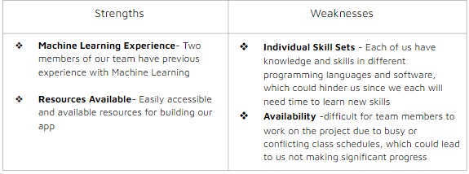
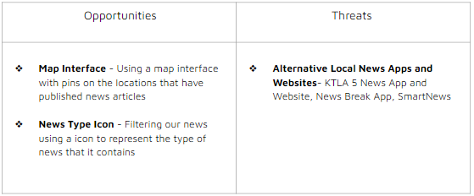
S.W.O.T
Unfair Advantage
Geolocal discovery of news presented via a fun map interface that to our knowledge, has very little precedent.
Accurate aggregation and labeling of local news media (location, topic, etc…) via Machine Learning.

Slide 6
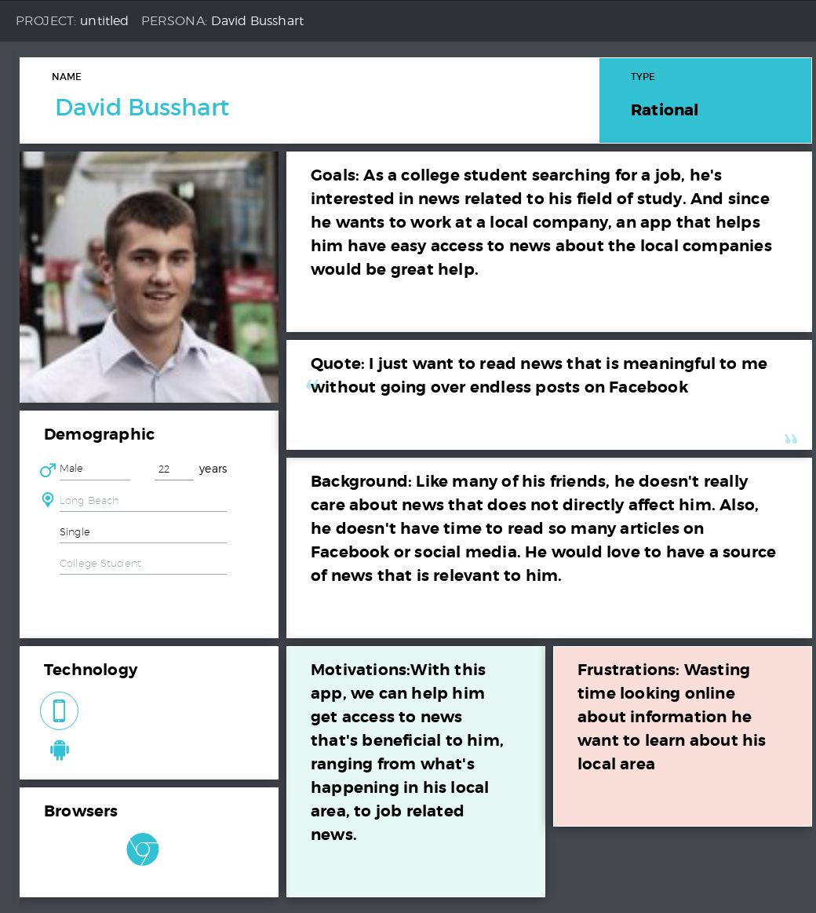
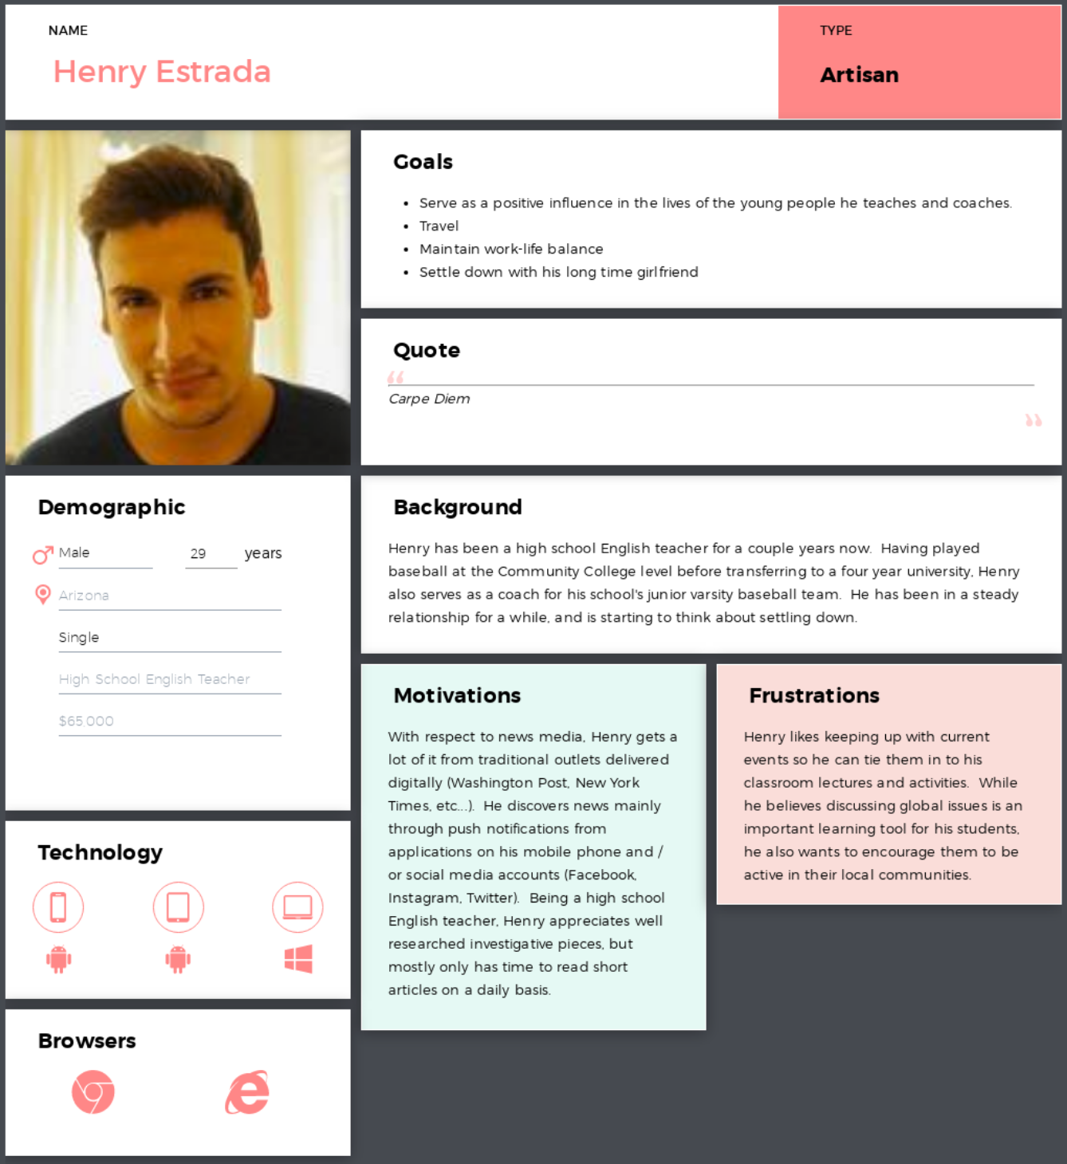
User Profile

Slide 7
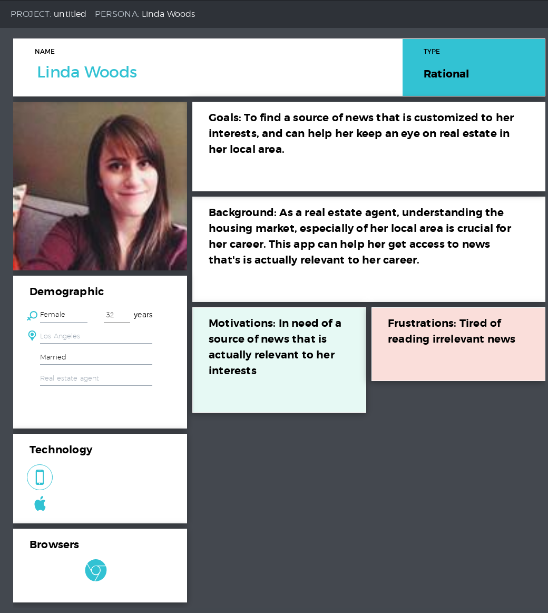

Slide 8
Primary Market Research
Asked 9 questions in first survey. Next survey will include 11+ questions.

Slide 9
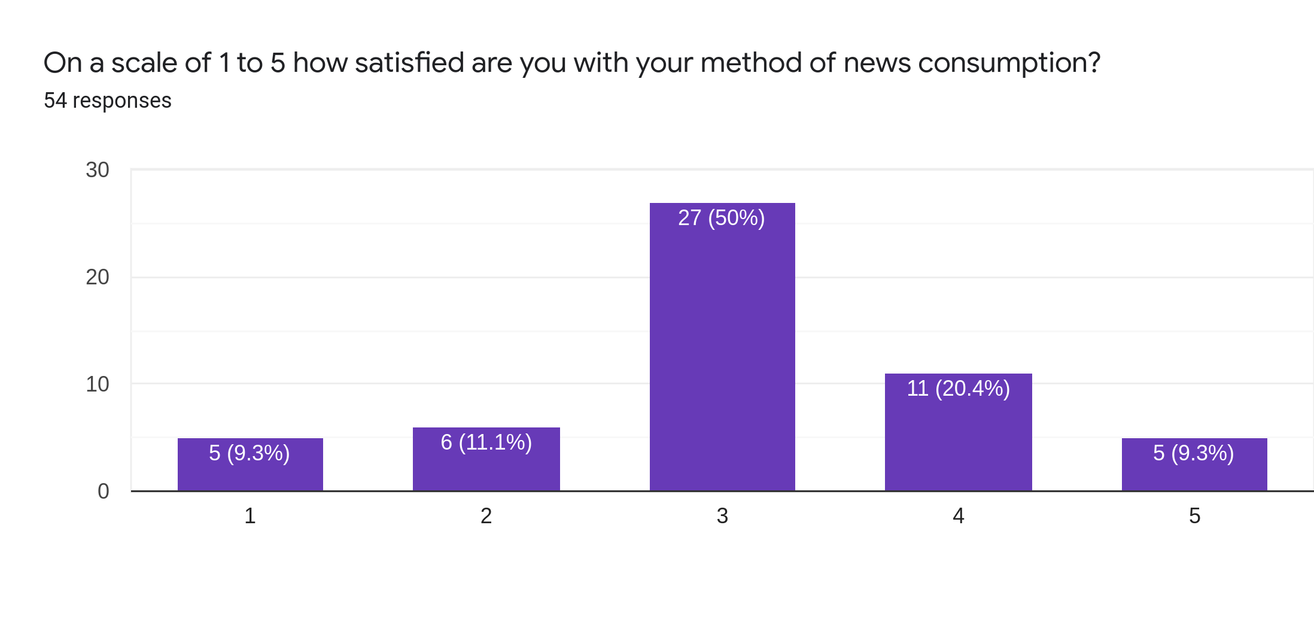

Slide 10
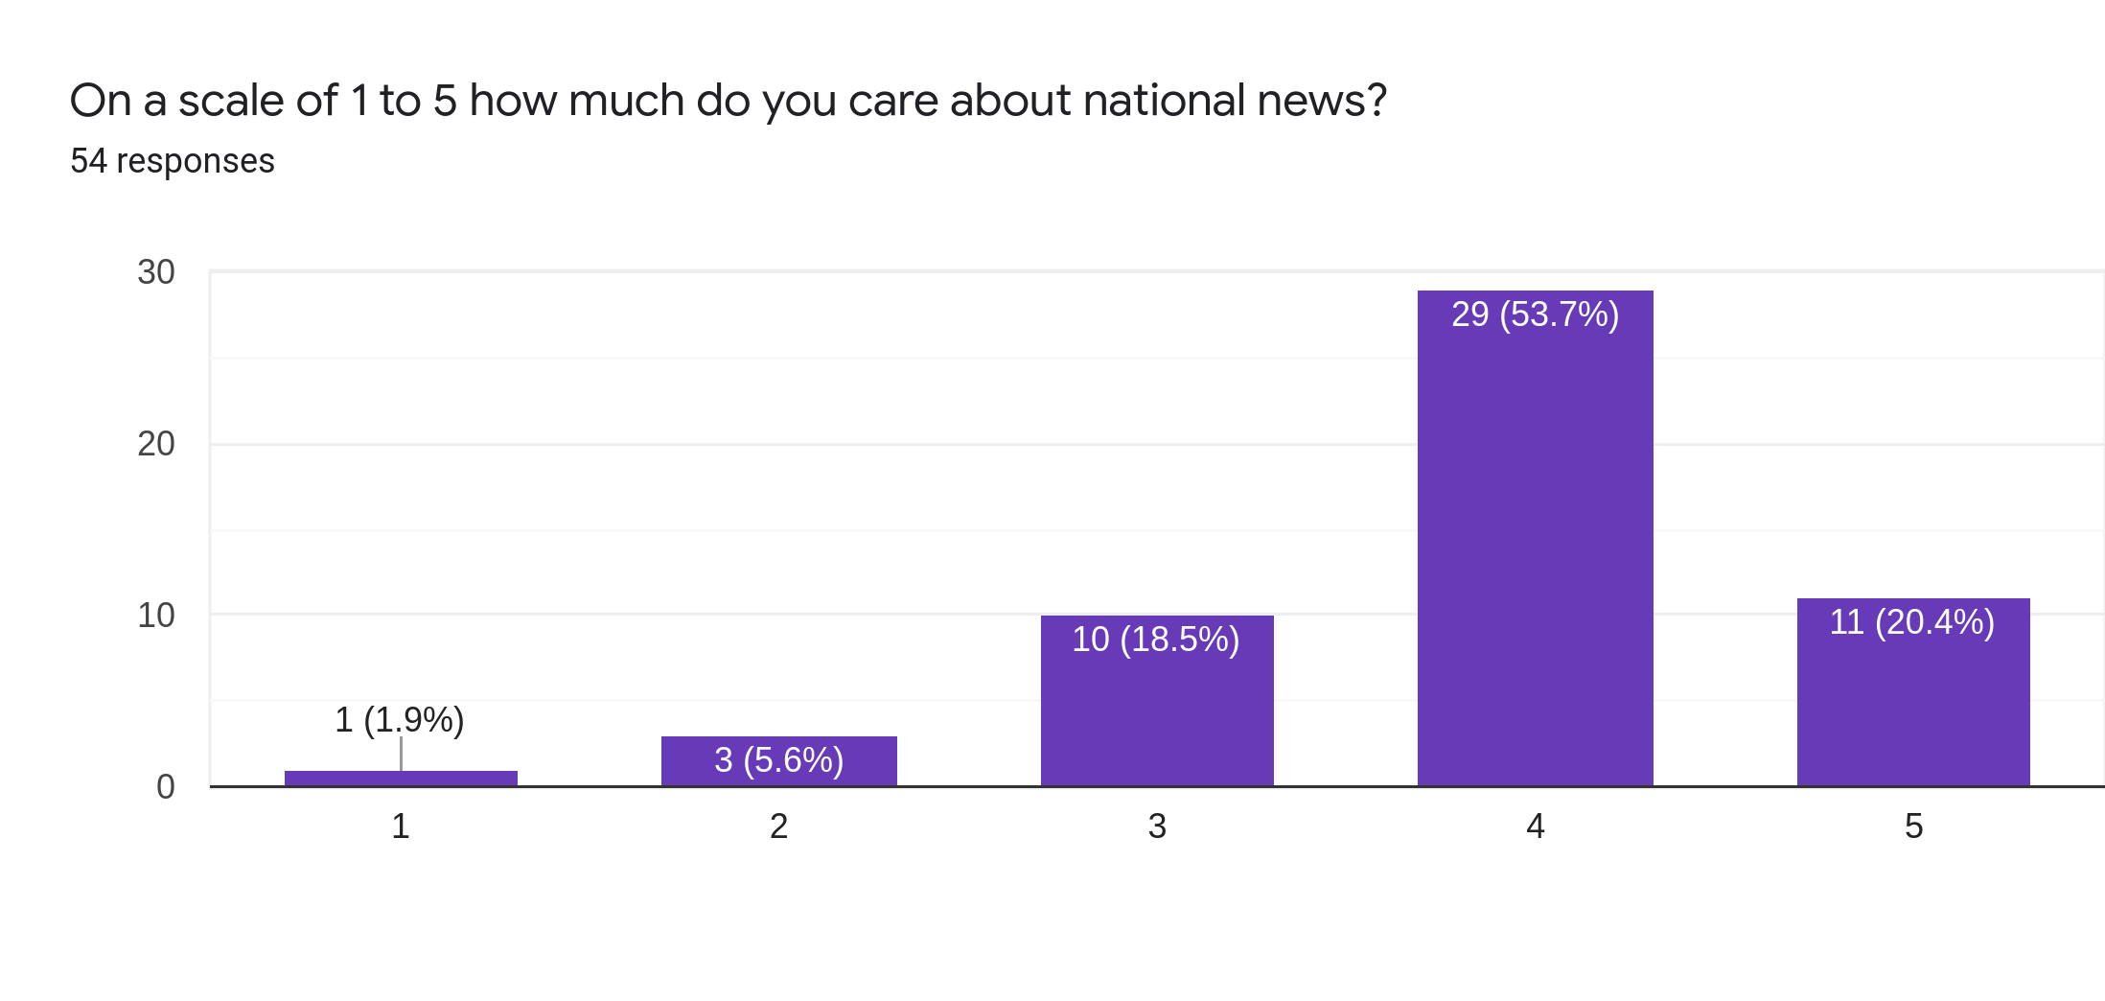

Slide 11
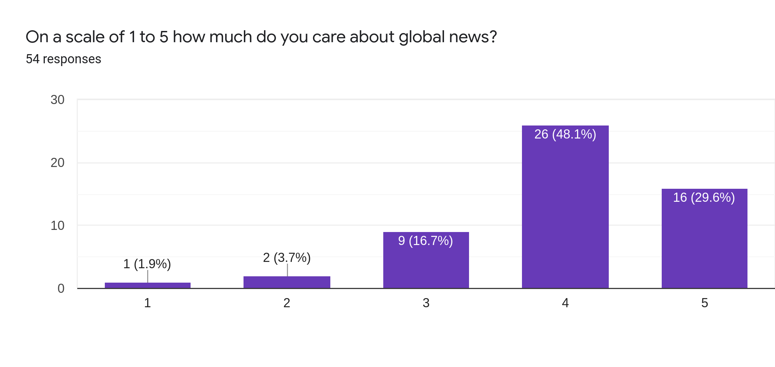

Slide 12
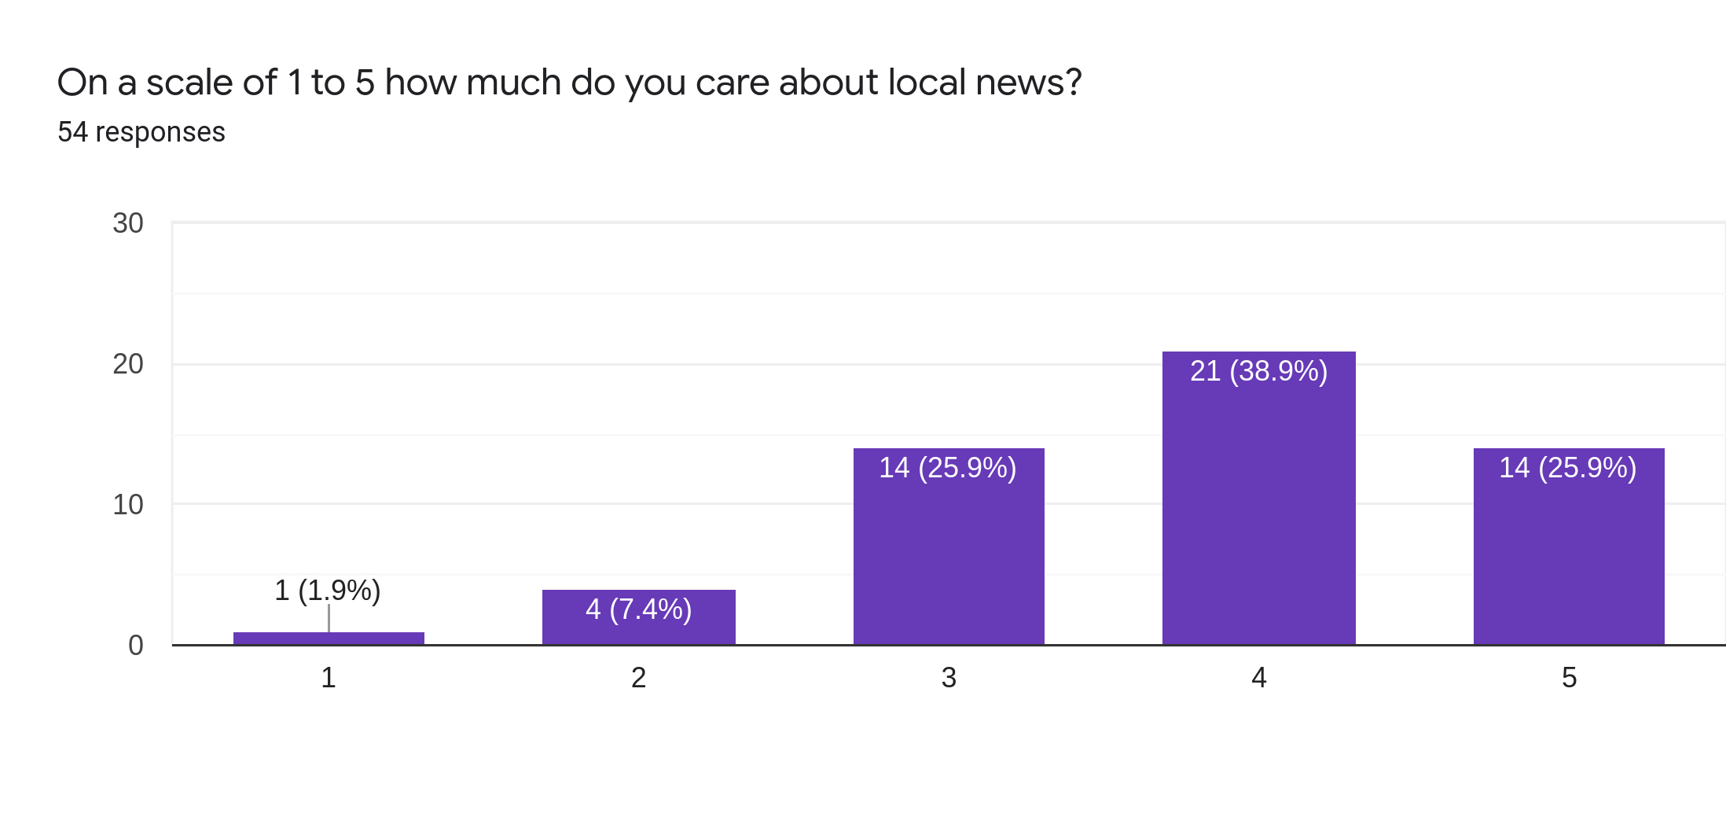

Slide 13
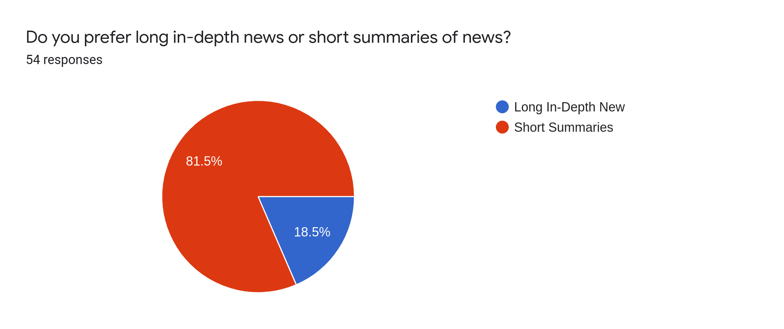

Slide 14
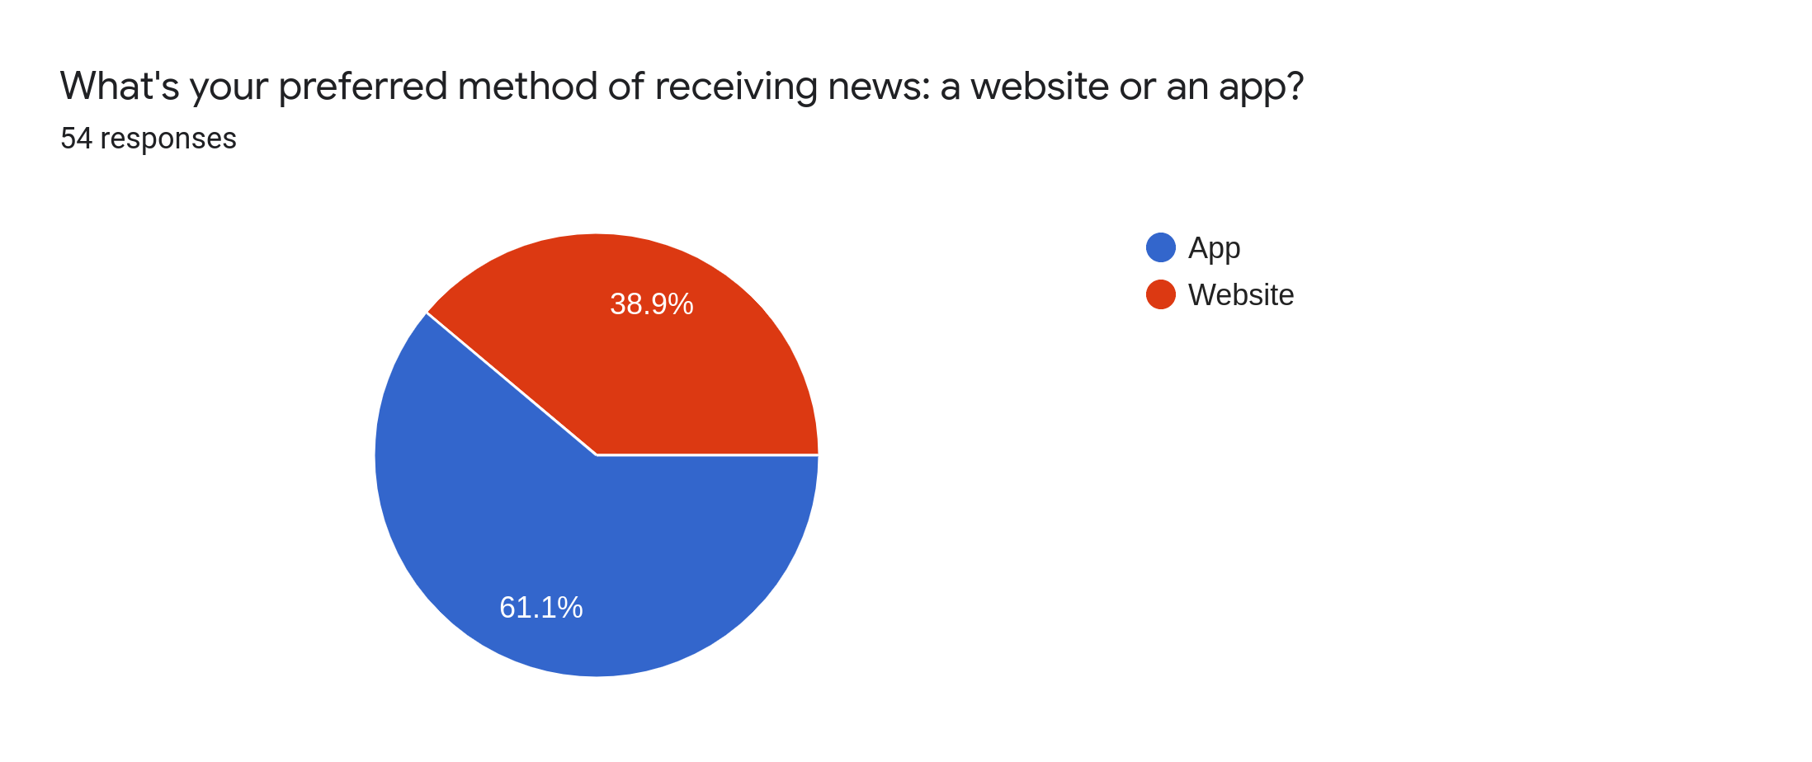

Slide 15
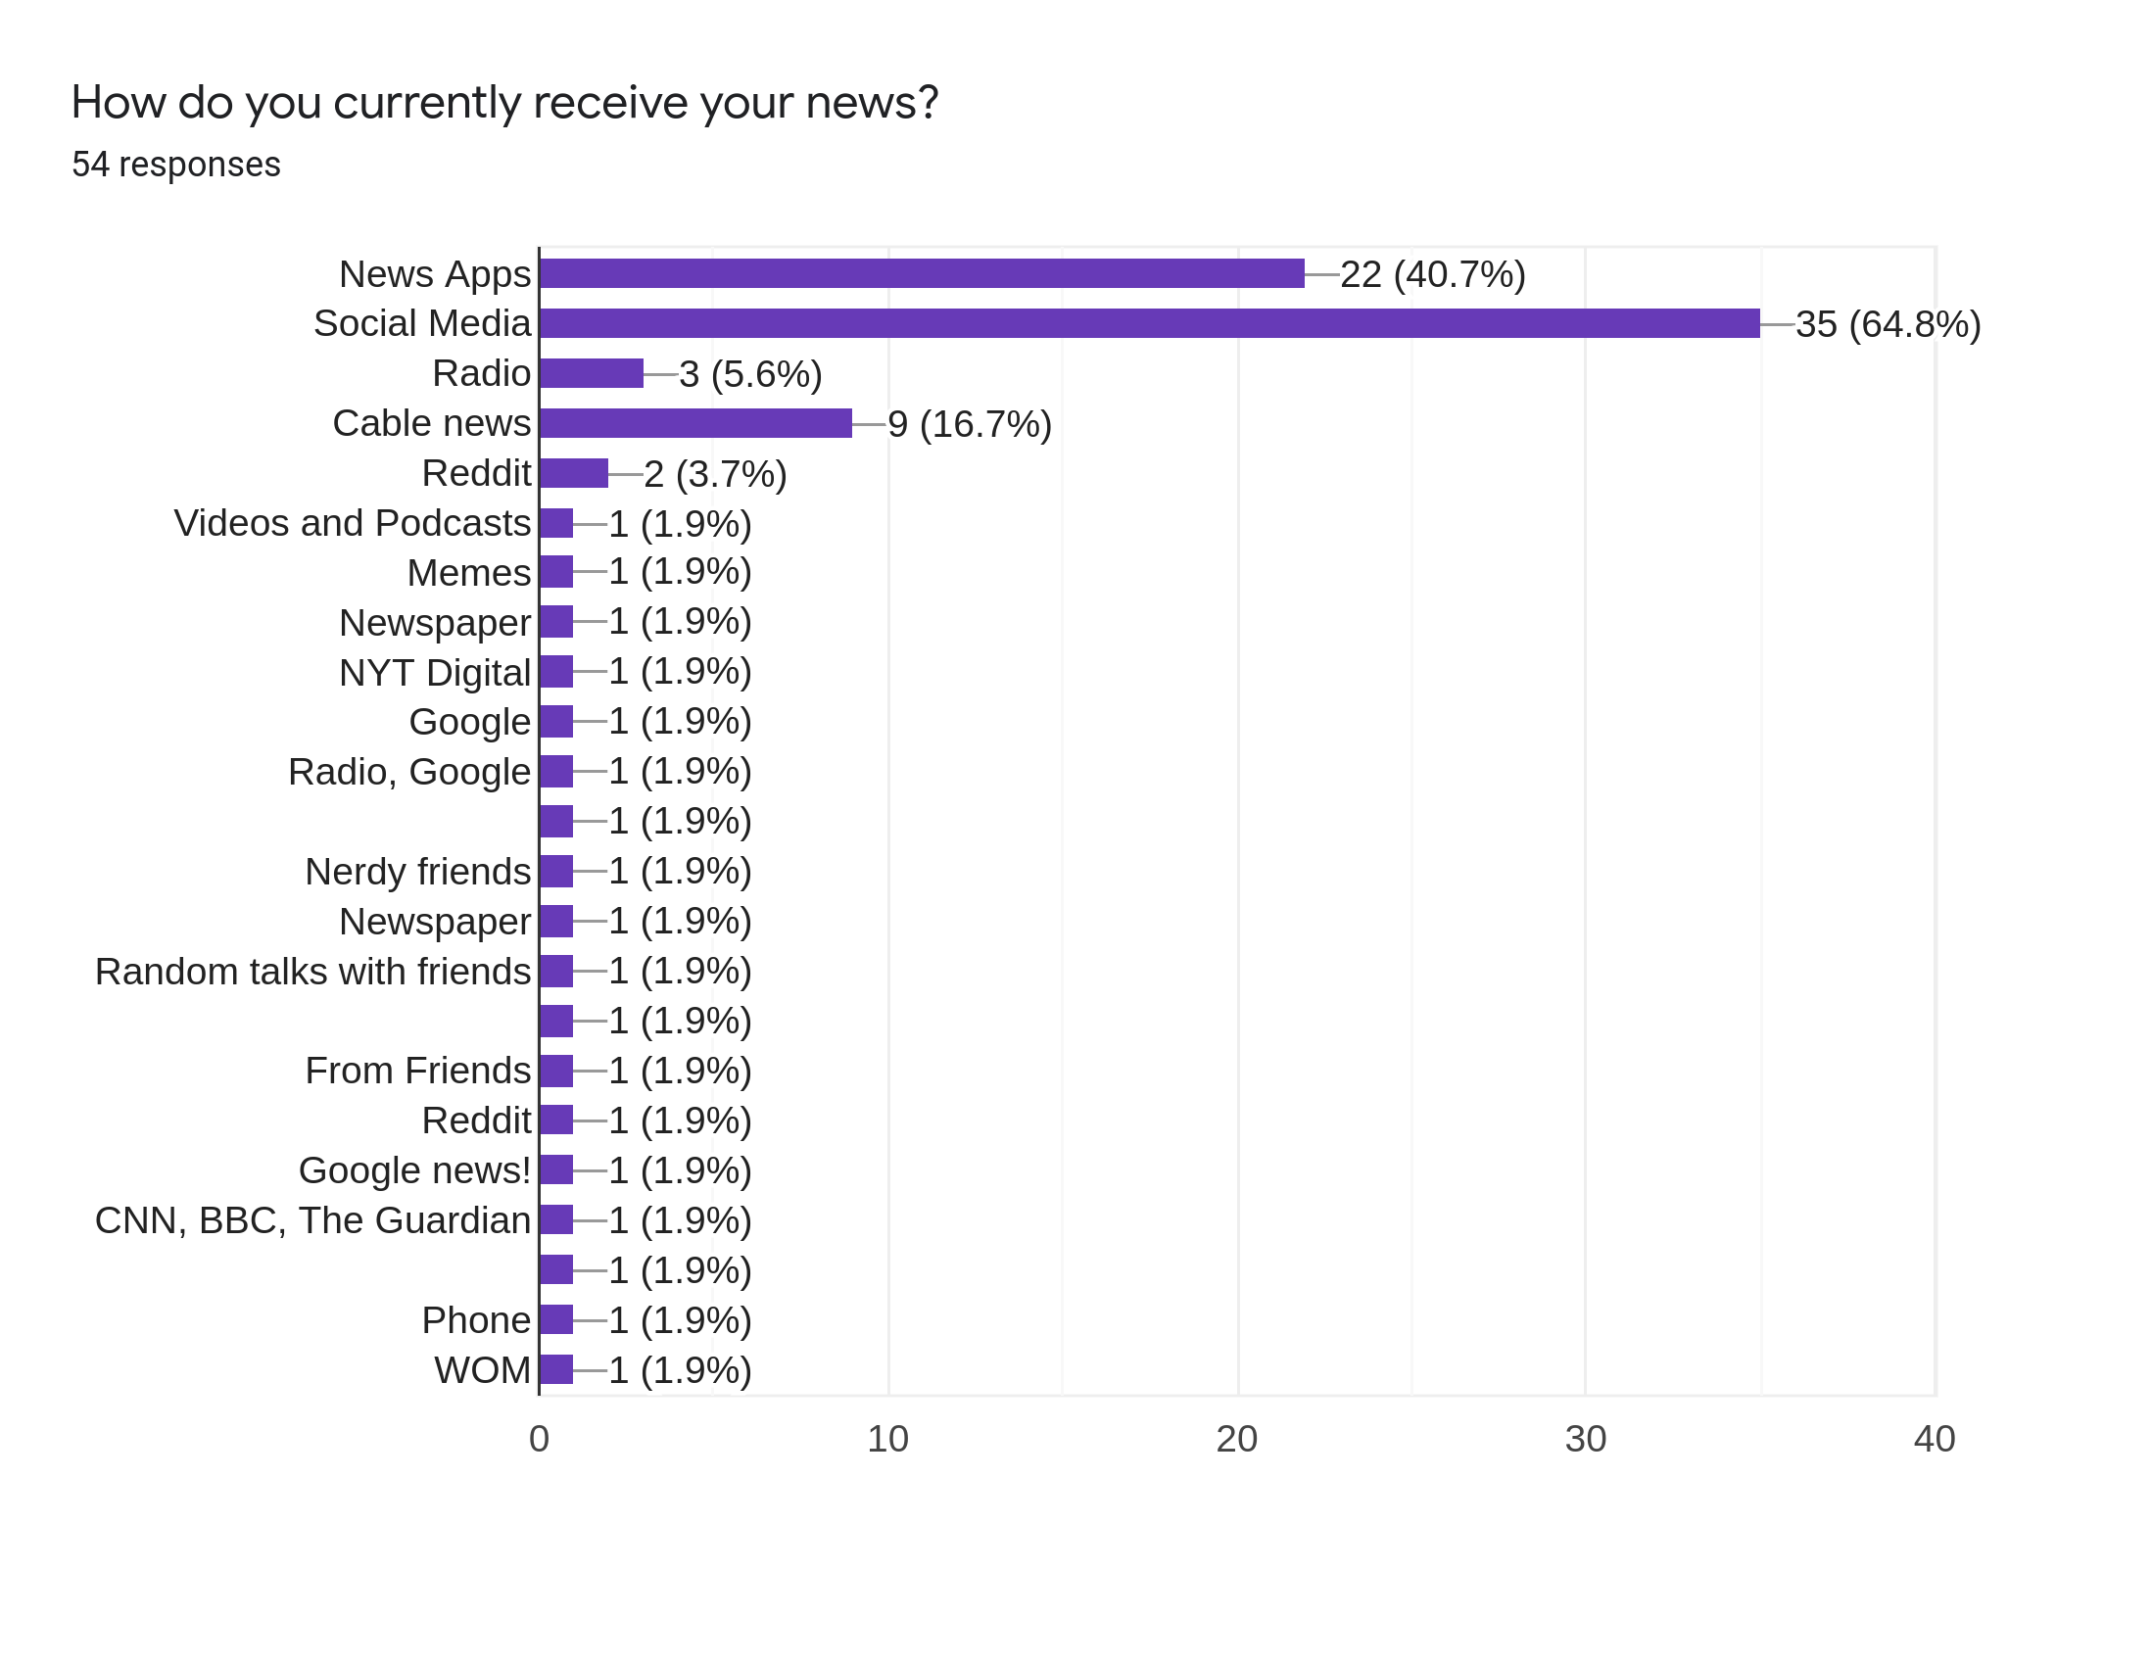

Slide 16
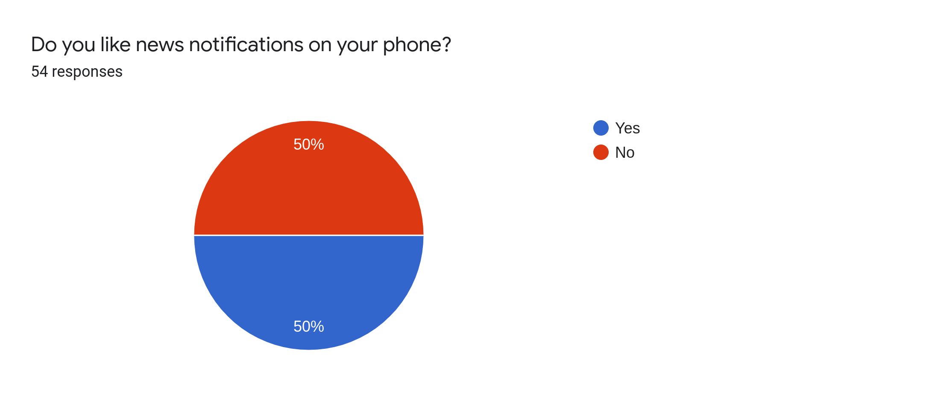

Slide 17
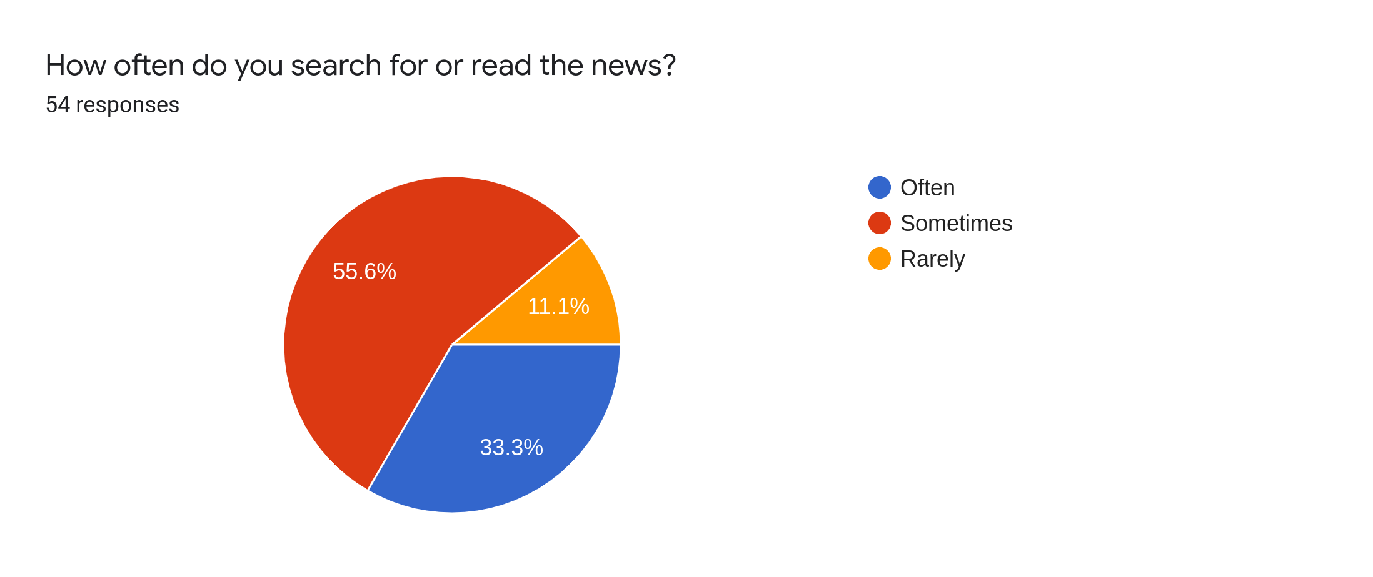

Slide 18
Hindsight
Should have added the following questions:
Would you like to filter the type of news you receive?
Would you enjoy seeing news on a map based on its locality?

Slide 19
Secondary Market Research
69% of millennials read news at least once a day.
Main sources are from YouTube, Instagram or Facebook.
There is a rising market for news applications.
Current competitor: InShorts, USA Live
Smartphone users are mainly of 18-34 age demographic.
Most people prefer summarized form of news.

Slide 20
Sprint Retrospective
Sprint Goal:
Complete the Business Requirements Document
Management Plan Document
Set up React Native on our computers

Slide 21
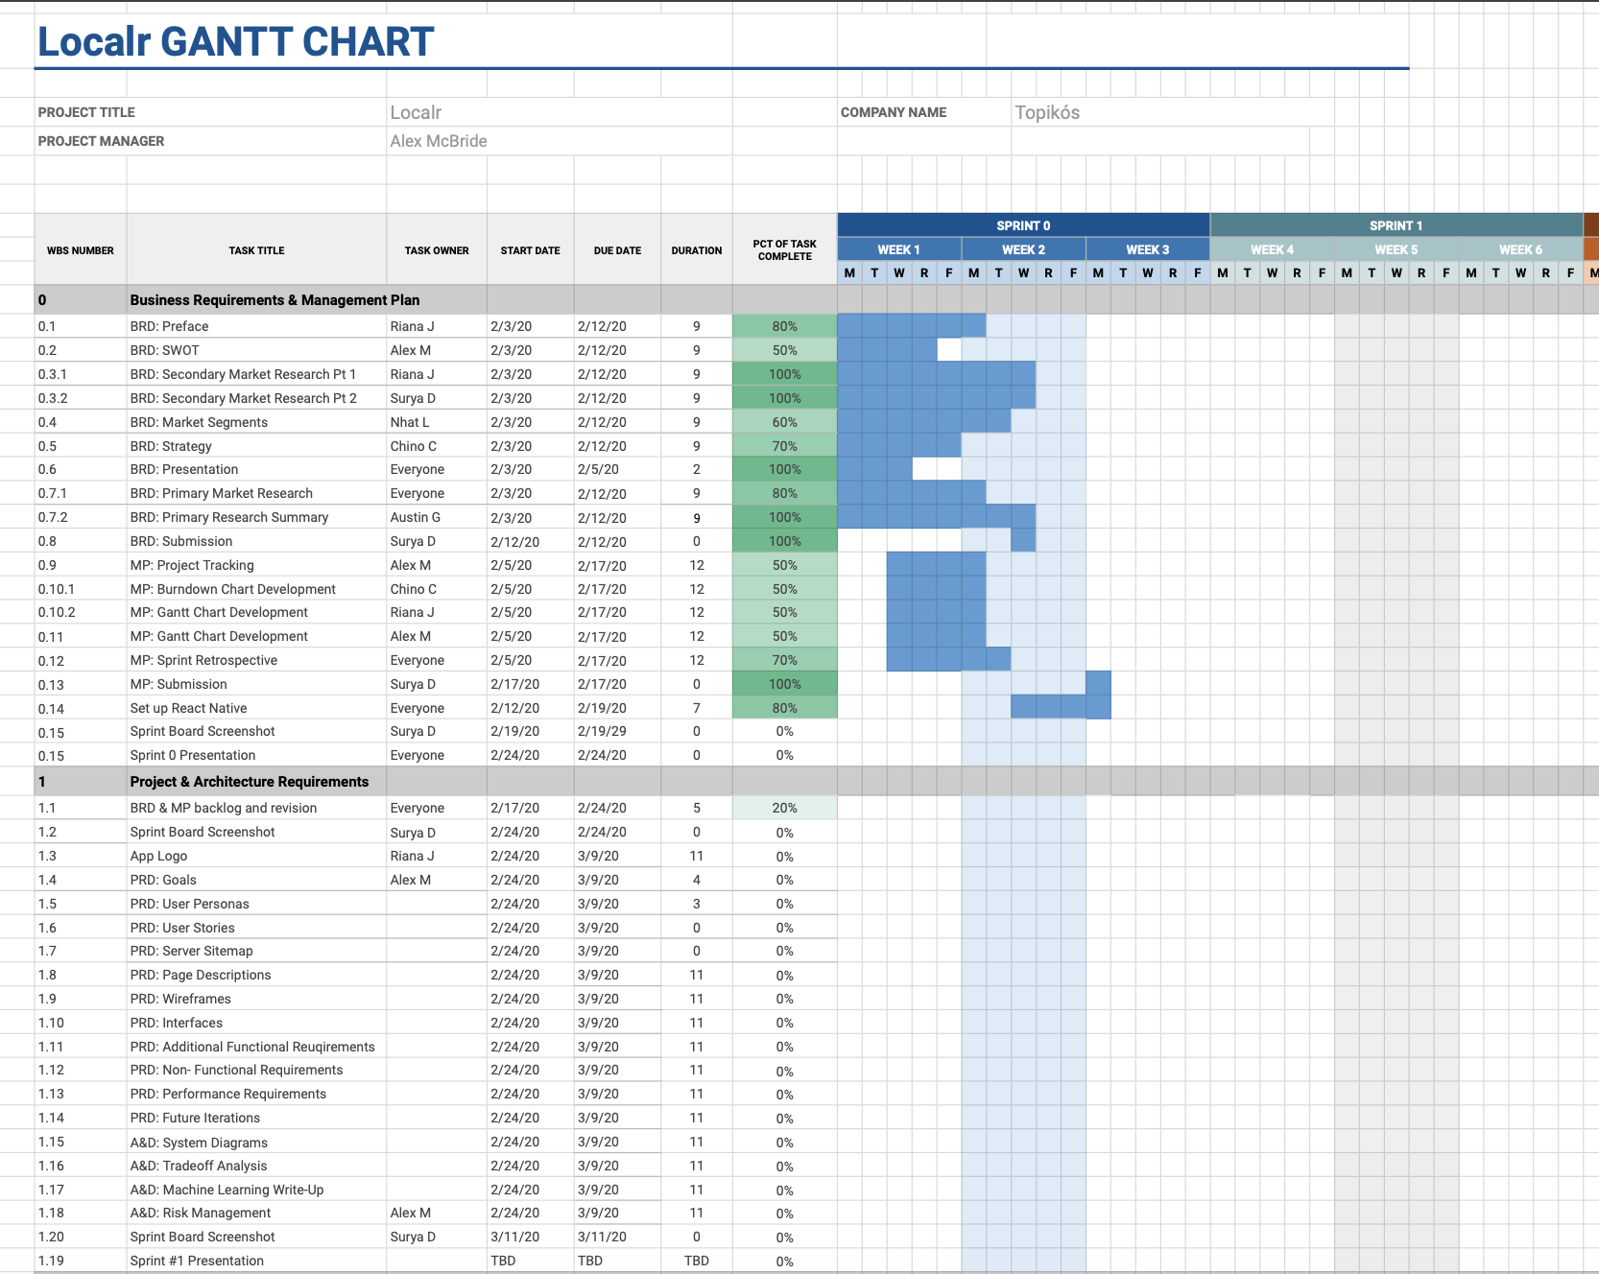
Gantt Chart

Slide 22
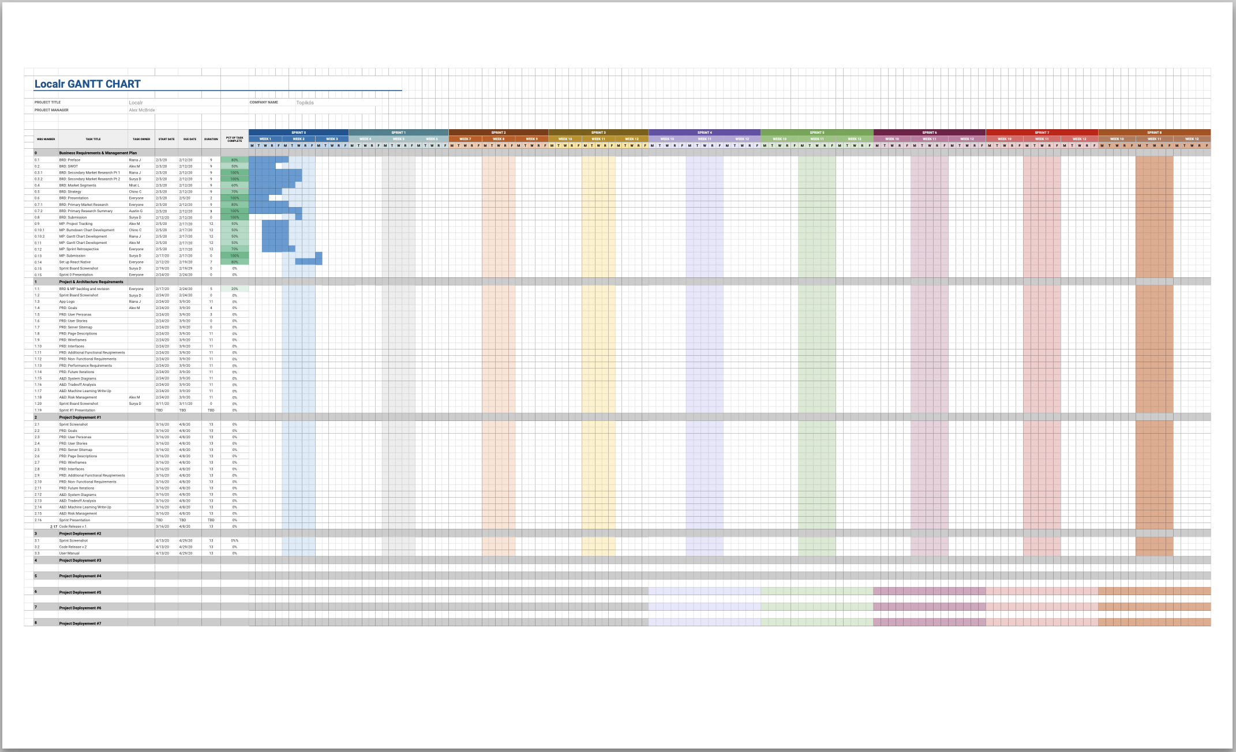
Gantt Chart

Slide 23
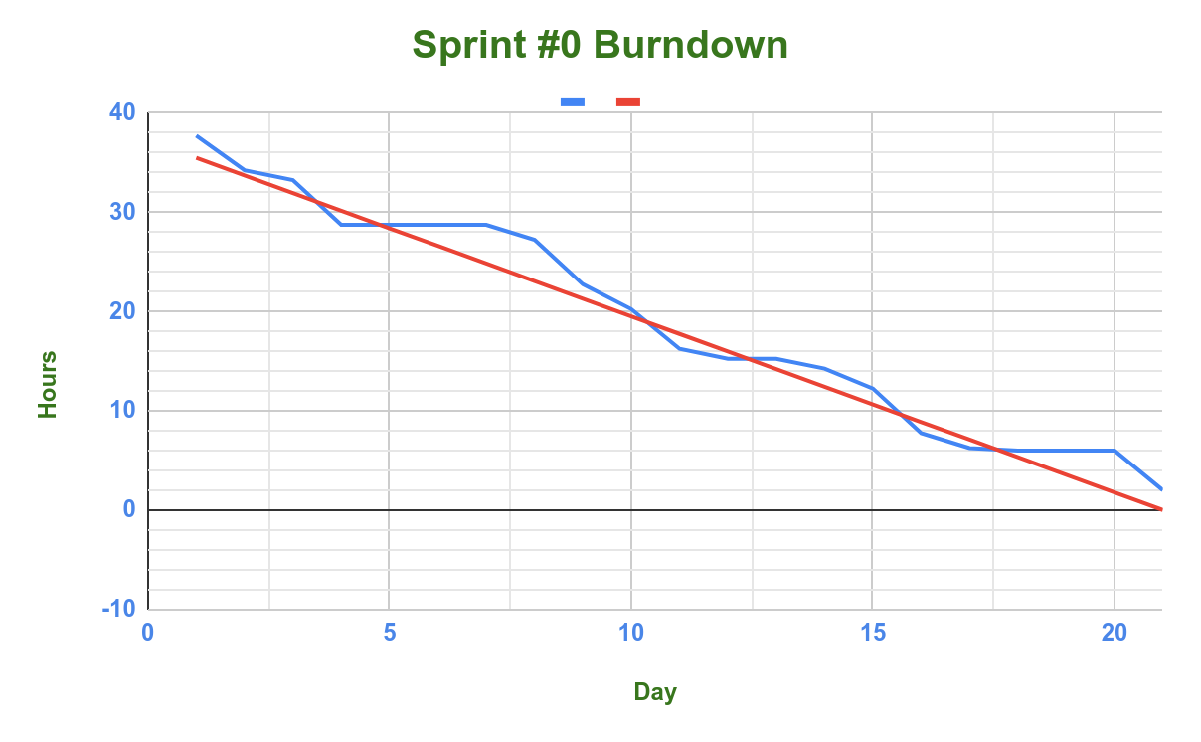
Burndown Chart

Slide 24
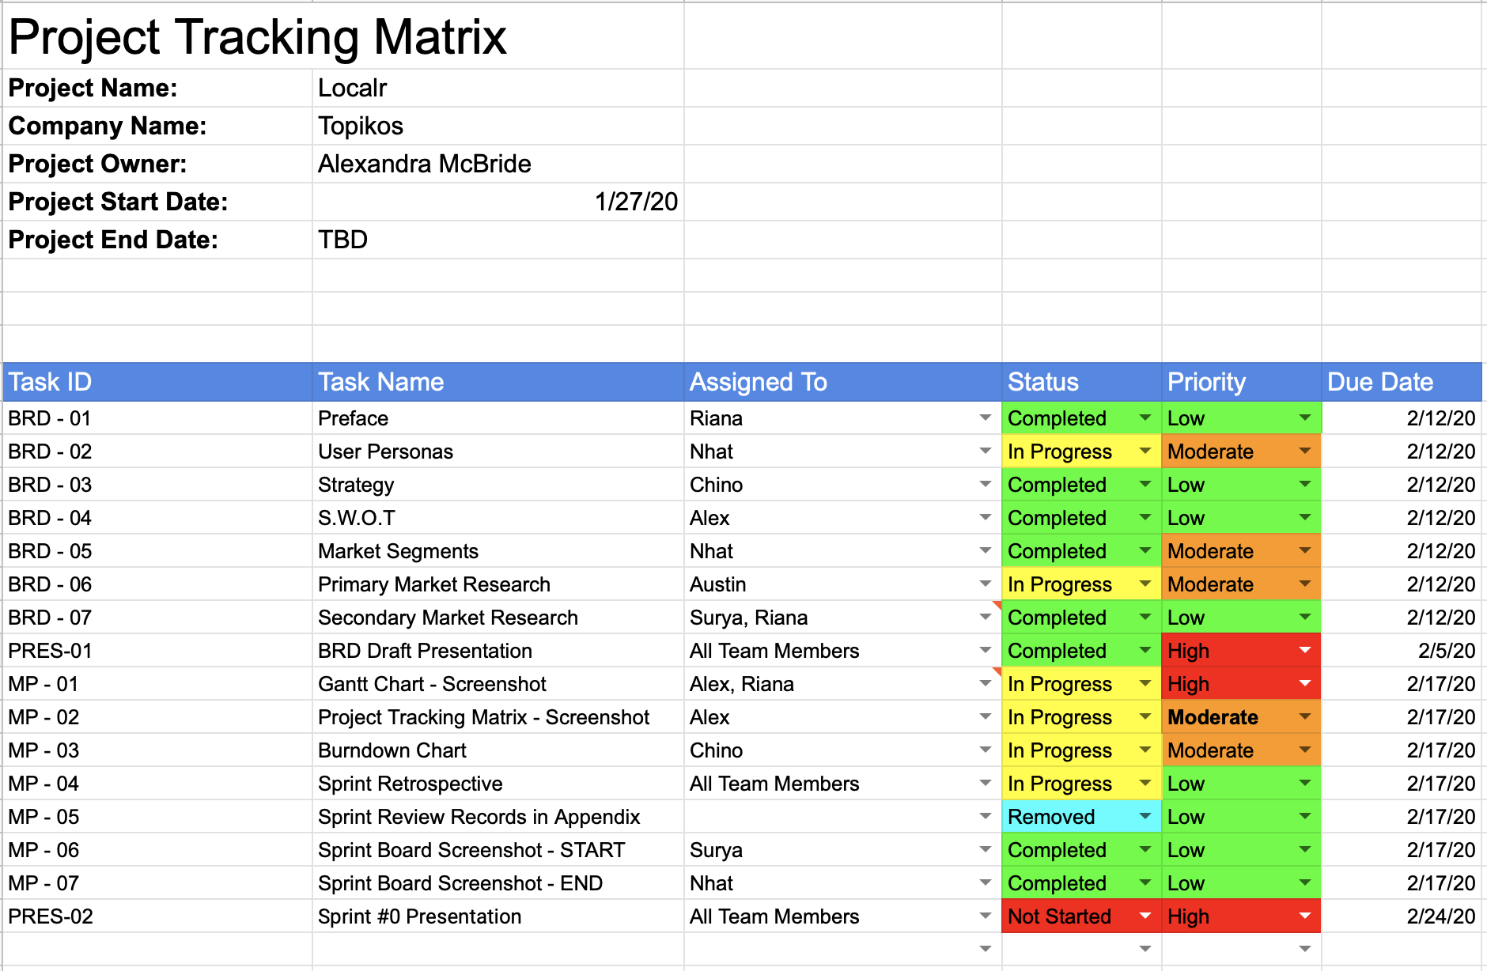
Project Tracking Matrix

Slide 25
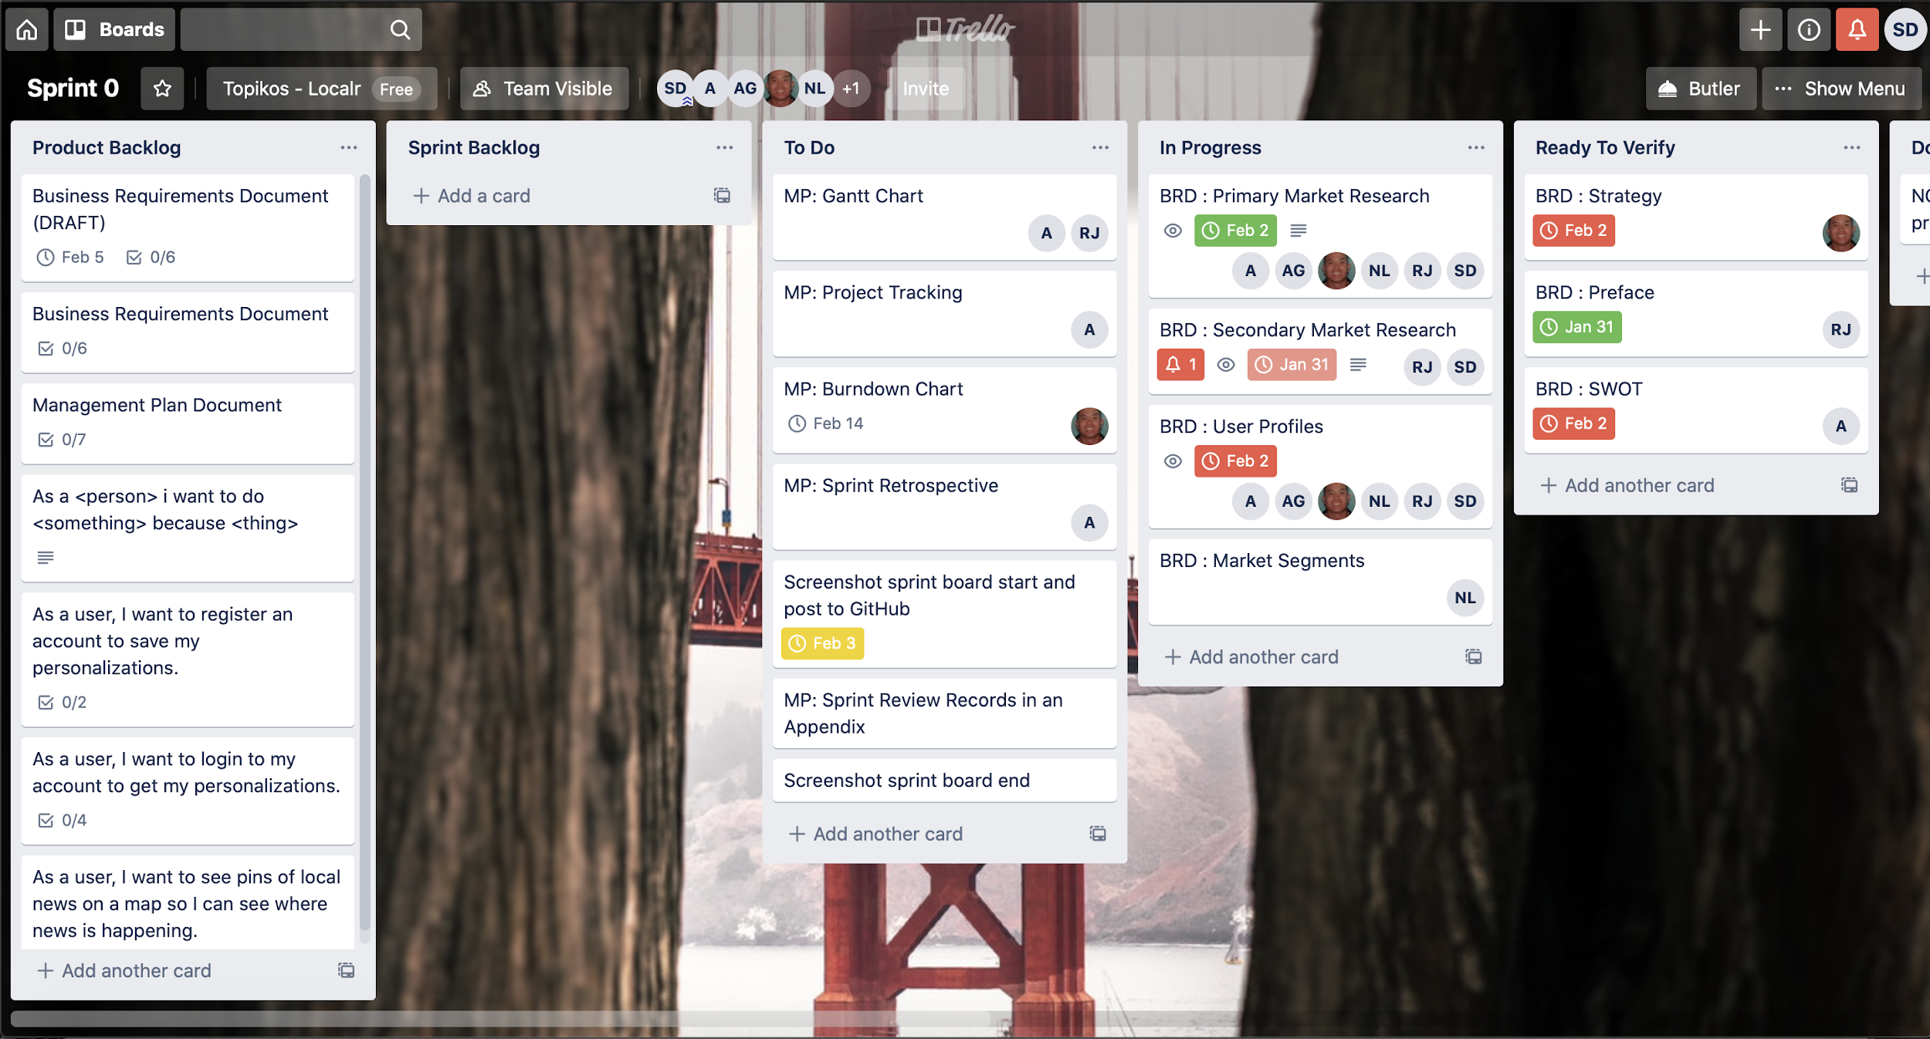
Sprint Board

